Slide 1
Variation
IGCSE Biology
https://www.britannica.com/science/heredity-genetics/Epistatic-genes#ref50781

Slide 2
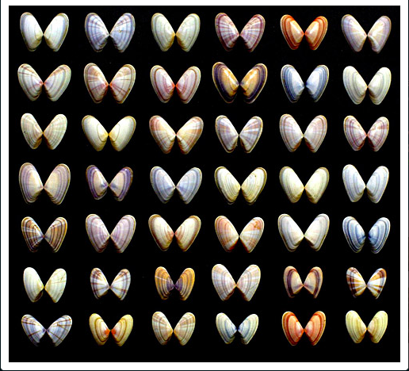
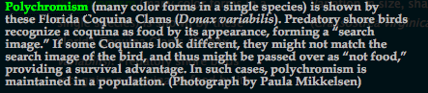
Variation
The differences among the individual of the same species.

Slide 3
Variation
Upon closer examination, many variations can be noted. Many can be easily observed, such as size, shape, color, texture, speed, etc.
Others might be more difficult to observe.
For example, there are often variations in the ability to produce offspring, hunting or hiding skills, and the ability to resist heat, cold, stress, drought, disease, etc.
Notes:
In short, all phenotypic expressions have both hereditary and environmental components, the amount of each varying for different traits. Thus, a trait that is primarily hereditary (e.g., skin colour in humans) may be modified by environmental influences (e.g., suntanning). And conversely, a trait sensitive to environmental modifications (e.g., weight in humans) is also genetically conditioned.
The variations that occur among healthy persons are, as a general rule, caused by polygenes with individually small effects.

Slide 4
Variation
Continuous Variation
Discontinuous/ discrete Variation
Results in a spectrum/ continuum of variety without clear-cut, separate categories;
Example: shell color.
There are not only light and dark varieties but also a range of hues in between.
Exists in a limited number of clearly separable varieties;
Example: gender
Continuous variation from light to dark color and discrete variation between male and female in the Eastern Oyster (Crassostrea virginica).
Notes:
Continuous Variation measured on a continuum rather than in discrete units or categories (e.g., height in human beings, shell length in bivalves).
Discrete Variation within a limited number of categories (e.g., gender — male or female).
Many individual traits are affected by more than one gene. For example, the coat colour in many mammals is determined by numerous genes interacting to produce the result.
Two or more genes may produce similar and cumulative effects on the same trait. In humans the skin-colour difference between so-called blacks and so-called whites is due to several (probably four or more) interacting pairs of genes, each of which increases or decreases the skin pigmentation by a relatively small amount.

Slide 5
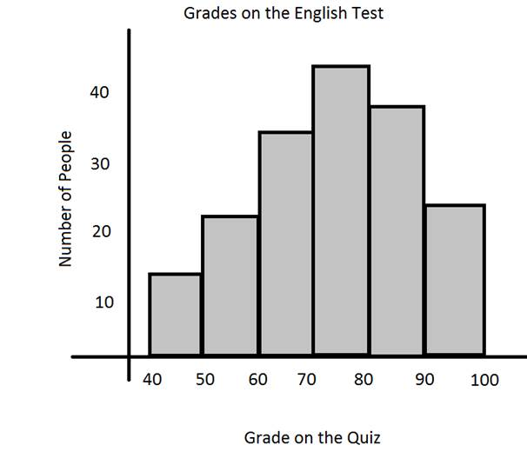
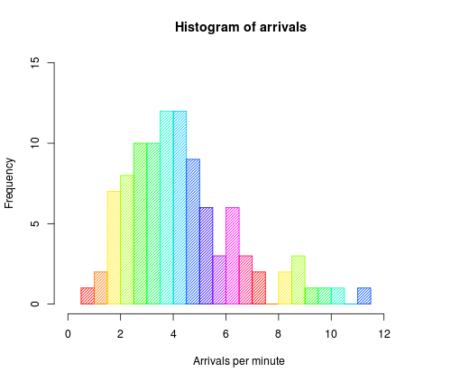
Histogram
Histograms show a distribution of numerical data. To make a histogram, first, divide the entire range of values into a series of intervals—and then count how many values fall into each interval.
The bins (intervals) are usually specified as consecutive, non-overlapping intervals of a variable. The bins must be adjacent and are often (but not required to be) of equal size.

Slide 6
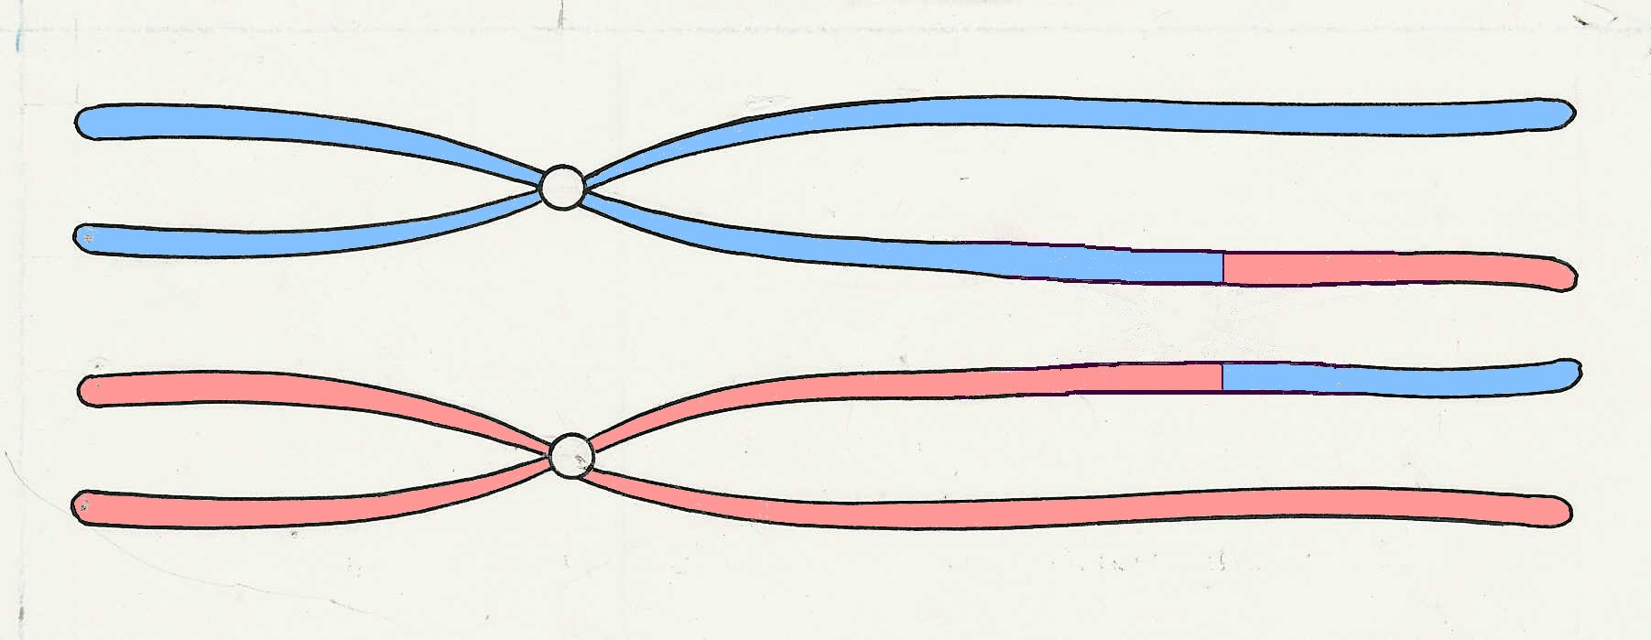
Sources of genetic variation
https://www.thoughtco.com/genetic-recombination-373450
A
B
1. Mutation
2. Meiosis:
a) crossing over and exchange of sequences on homologous chromatids;
b) recombination between chromosomes during meiosis, called the law of independent assortment, meaning that the alleles of different genes get sorted into gametes independently of one another as well.
3. Random fertilisation & random mating between organisms
A
b
a
B
a
b
https://biologydictionary.net/allele/
https://biologydictionary.net/crossing-over/
Notes:
The laws of segregation and independent assortment deal with the way cells divide their DNA to prepare haploid cells as sperm and egg.
Although both alleles for a given trait start in the same diploid cell, they will be separated into separate eggs or sperm by the end of meiosis. This, the law of segregation, means that while a recessive allele can be masked in the expression of an organism, it has the same chance of being passed on to the offspring as a dominant allele.
Also important is the law of independent assortment, which says that the alleles from the same gene will be sorted independently of alleles from other genes. This is important because it gives rise to the enormous complexity of life. From the same pea plant parents, thanks to these laws, you could receive offspring with any combination of traits, even if the parents looked the same.

Slide 7
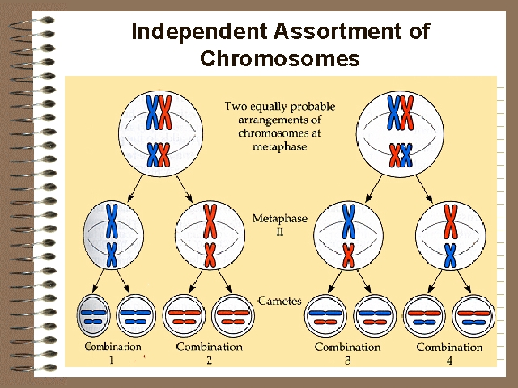
Law of independent assortment
Two possible recombination between chromosomes during 1st cell division of meiosis.
Assortment of chromosomes is independent of each other.
Sperm 1
Sperm 2
Sperm 3
Sperm 4
Notes:
During meiosis, chromosomes derived from the maternal and paternal gamete can assort independently from one another. In other words, chromosomes from the mother or the father can be chosen randomly for each gamete. A human sperm can contain chromosomes 1, 3, 5, 7, 9, 21 and 23 from his female parent, and the rest can arise from the male parent. Similarly, an egg can have only two chromosomes from the female parent and the rest from the male parent.

Slide 8
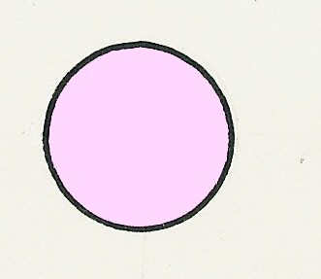
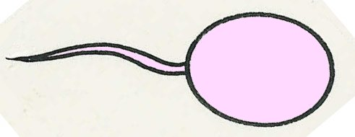
Recombinations
5
Possible recombinations at fertilisation
ova
bC
bc
sperms
Bb
Cc
Bb
cc
Bc
bc
bb
Cc
bb
cc
Bbcc Brown eyes, straight hair – like father
bbCc Blue eyes, curly hair – like mother
BbCc Brown eyes, curly hair – new variation
bbcc Blue eyes, straight hair – new variation
Notes:
Although this is a useful illustration of how new variations can arise by independent assortment, it should be remembered that, in fact, eye colour and hair curliness are not controlled by single genes.
There is a range of eyes colours e.g. grey, blue, green, hazel, brown.
There is a range of hair curliness e.g. straight, wavy, curly, woolly.
The next sequence gives a more accurate example of recombination of genes.

Slide 9
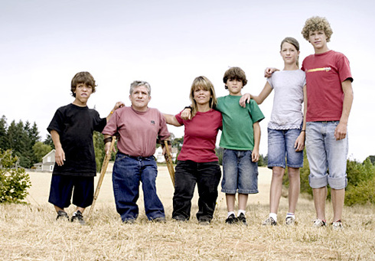
Mutations
A mutation is a change in a gene/ DNA sequence or chromosome.
Examples of gene mutations in humans:
Albinism– cannot make melanin pigment (danger of skin damage).
Sickle cell anaemia
Cystic fibrosis
Haemophilia
Colour blindness
Dwarfism

Slide 10
Albinism
Albino alligator
Normal alligator
Notes:
Albinism is the “congenital absence of any pigmentation or coloration in a person, animal or plant, resulting in white hair, feathers, scales and skin and pink eyes (resulting from the lack of pigment in the iris allowing the blood vessels of the retina to be visible) in mammals, birds, reptiles, amphibian and fish and invertebrates as well.
In plants, albinism is characterised by partial or complete loss of chlorophyll pigments and incomplete differentiation of chloroplast membranes.

Slide 11
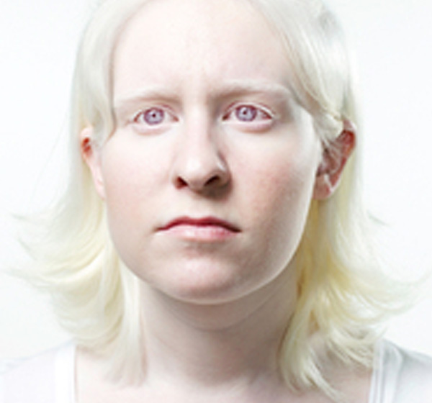

Albinism
Albinism is a group of inherited disorders that results in little or no production of the pigment melanin, which determines the color of the skin, hair and eyes. Melanin also plays a role in the development of certain optical nerves, so all forms of albinism cause problems with the development and function of the eyes.
Mutations in several different genes, on different chromosomes, can cause different types of albinism.
Notes:
There are three basic types of melanin: eumelanin, pheomelanin, and neuromelanin. The most common type is eumelanin, of which there are two types— brown eumelanin and black eumelanin. Pheomelanin is a cysteine-derivative that contains polybenzothiazine portions that are largely responsible for the color of red hair, among other pigmentation. Neuromelanin is found in the brain.
In the human skin, melanogenesis is initiated by exposure to UV radiation, causing the skin to darken. Melanin is an effective absorbent of light;
Studies have shown a lower incidence for skin cancer in individuals with more concentrated melanin, i.e. darker skin tone. However, the relationship between skin pigmentation and photoprotection is still uncertain.

Slide 12
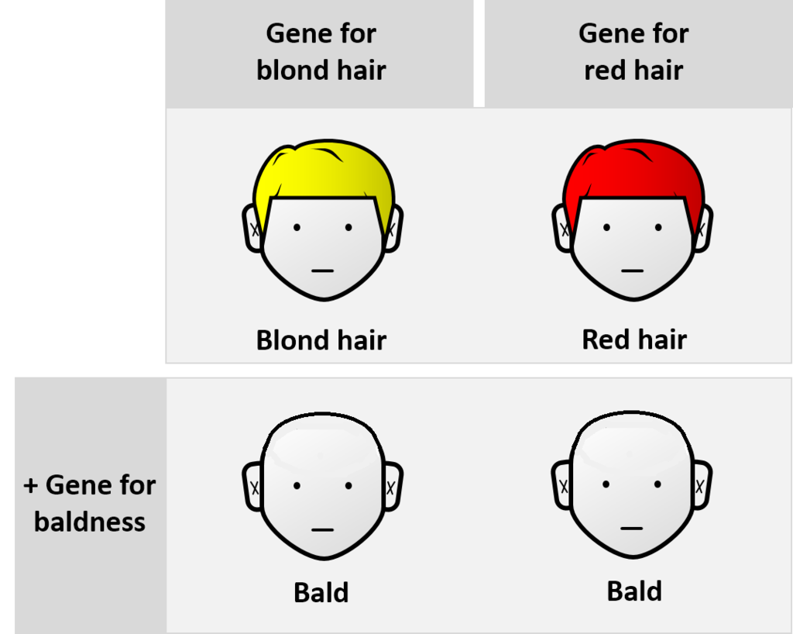
epistasis
Epistasis is a phenomenon in genetics in which the effect of a gene mutation is dependent on the presence or absence of one or more other genes.
In classical genetics, if genes A and B are mutated, and each mutation by itself produces a unique phenotype but the two mutations together show the same phenotype as the gene A mutation, then gene A is epistatic and gene B is hypostatic.
For example, the gene for total baldness is epistatic to the gene for brown hair. In this sense, epistasis can be contrasted with genetic dominance, which is an interaction between alleles at the same gene locus.
Notes:
An example of epistasis is the interaction between hair colour and baldness. A gene for total baldness would be epistatic to one for blond hair or red hair. The hair-colour genes are hypostatic to the baldness gene. The baldness phenotype supersedes genes for hair colour.

Slide 13
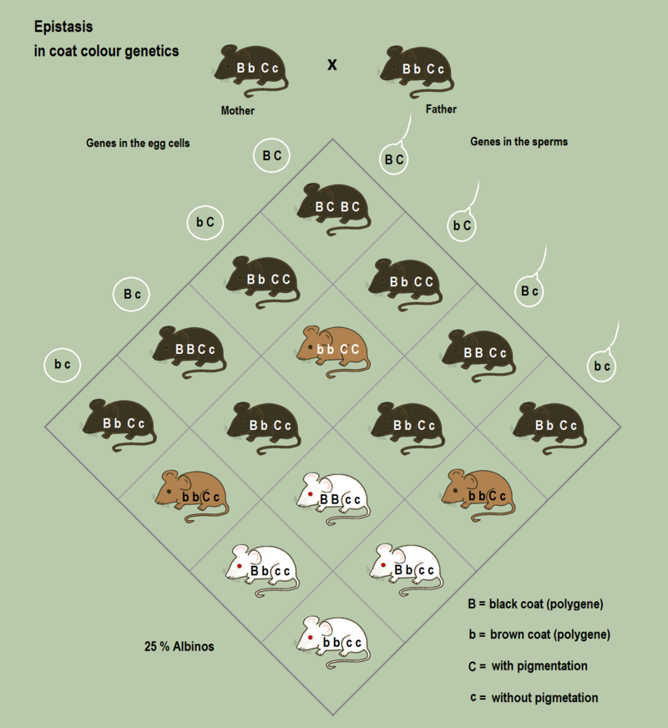
epistasis
Example of epistasis in coat colour genetics: If no pigments can be produced the other coat colour genes have no effect on the phenotype, no matter if they are dominant or if the individual is homozygous.
Here the genotype "c c" for no pigmentation is epistatic over the other genes

Slide 14
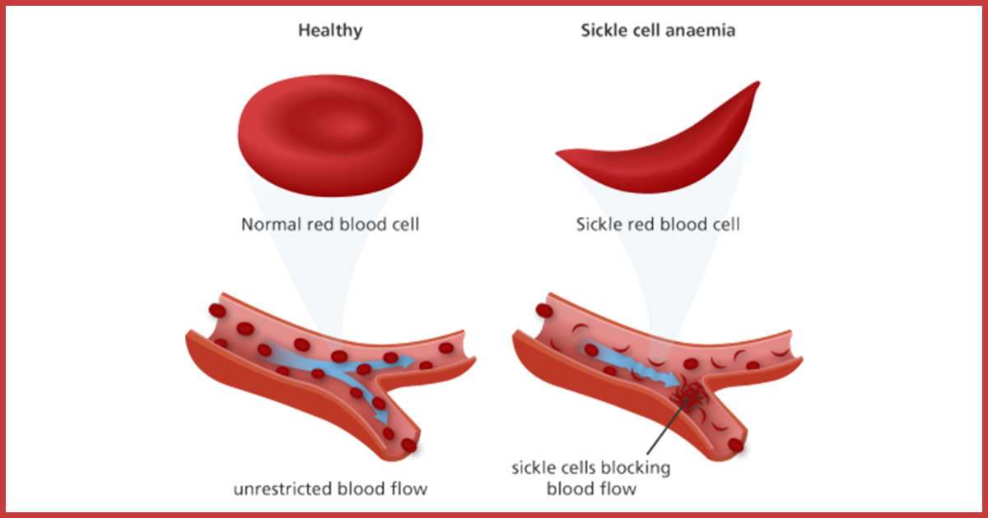
Sickle cell anaemia
Sickle cell anaemia is a part of sickle cell disease which is a genetic condition affecting the haemoglobin in our red blood cells. This impairs its function of carrying oxygen in the blood and hence can cause symptoms of anaemia such as dizziness, rapid heart rate and fatigue.

Slide 15
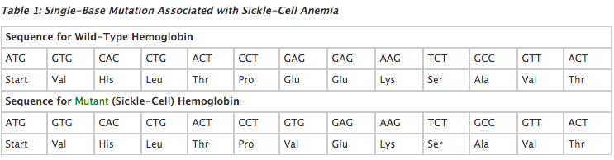
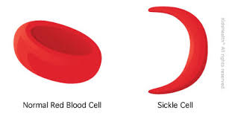
Sickle cell anaemia
Molecules of sickle-cell hemoglobin stick to one another, forming rigid rods. These rods cause a person's red blood cells to take on a deformed, sickle-like shape
https://dnalc.cshl.edu/view/15532-Sickle-cell-anemia-3D-animation-with-narration.html

Slide 16
Cystic fibrosis
Cystic fibrosis (CF) is a genetic condition that affects a protein (CFTR) in the body.
The CFTR protein is located in every organ of the body that makes mucus, including the lungs, liver, pancreas, and intestines, as well as sweat glands.
People who have cystic fibrosis make thick, sticky mucus that can build up and lead to blockages, damage, or infections in the affected organs. Inflammation also causes damage to organs such as the lungs and pancreas.

Slide 17
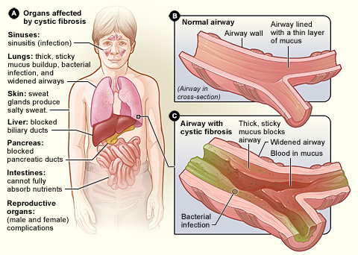

Slide 18
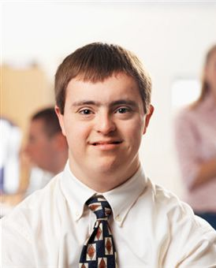
Mutations
Mutation may also affect larger sections of chromosomes, or even the whole chromosome. i.e. you may gain or lose a whole chromosome.
Down syndrome, also known as trisomy 21, is one of the most common chromosome abnormalities in humans. It occurs in about 1 in 1,000 babies born each year
It is usually associated with physical growth delays, mild to moderate intellectual disability, and characteristic facial features.
Down syndrome can be identified during pregnancy by prenatal screening.
The parents of the affected individual are usually genetically normal. The probability increases from less than 0.1% in 20-year-old mothers to 3% in those of age 45.
Q: Which process goes wrong can result in Down’s syndrome?
Notes:
The average IQ of a young adult with Down syndrome is 50, equivalent to the mental ability of an 8- or 9-year-old child, but this can vary widely.

Slide 19
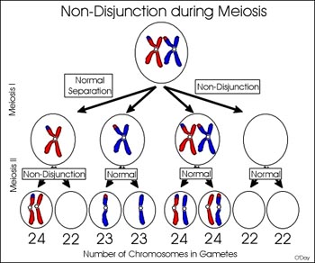

Slide 20
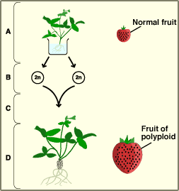
Mutations
Mutation may also affect the whole set of chromosomes. i.e. Organisms may gain one or more sets of chromosomes.
A: the strawberry plant is exposed to a chemical
B: due to the effect of chemical, total non-disjunction at meiosis produces diploid gametes(2n)
C: two diploid gametes fuse at fertilisation
D: a new plant develops which has four sets of chromosomes (4n)

Slide 21
Mutations
Mutations occur spontaneously/ naturally but there are factors that can increase the rate/ frequency of mutation.
Any factor that increases the rate of mutation is called a mutagen.
Chemicals – e.g. benzene (carcinogens).
Ionising radiation – e.g. UV rays in sunlight, nuclear radiation.

Slide 22
Radiation
In physics, radiation is the emission or transmission of energy in the form of waves or particles through space or through a material medium.
This includes:
electromagnetic radiation, such as radio waves, microwaves, infrared, visible light, ultraviolet, x-rays, and gamma radiation (γ)
particle radiation, such as alpha radiation (α), beta radiation (β), and neutron radiation (particles of non-zero rest energy)

Slide 23
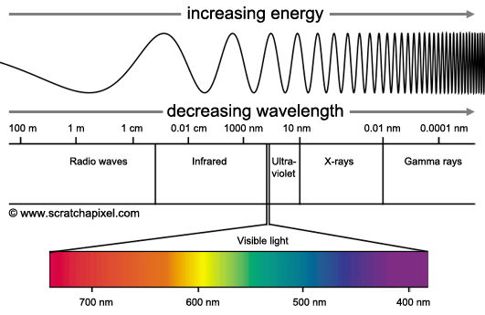
Radiation

Slide 24
Notes:
Gamma rays, X-rays, and the higher ultraviolet part of the electromagnetic spectrum are ionizing, whereas the lower ultraviolet part of the electromagnetic spectrum and all the spectrum below UV, including visible light, nearly all types of laser light, infrared, microwaves, and radio waves are considered non-ionizing radiation. The boundary between ionizing and non-ionizing electromagnetic radiation that occurs in the ultraviolet is not sharply defined, since different molecules and atoms ionize at different energies.

Slide 25
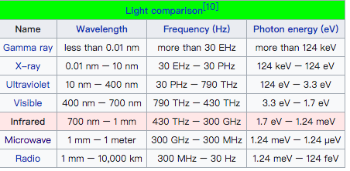
Radiation

Slide 26
Ionising radiation
Ionizing radiation is radiation that carries sufficient energy to detach electrons from atoms or molecules, thereby ionizing them.
This includes:
energetic subatomic particles, ions or atoms moving at high speeds (usually greater than 1% of the speed of light) (typically radioactive decay release alpha particles or beta particles, etc.)
electromagnetic waves on the high-energy end of the electromagnetic spectrum. E.g, X-rays, UV, gamma rays.
Ionizing radiation hazard symbol
Notes:
Typical ionizing subatomic particles found in radioactive decay include alpha particles, beta particles and neutrons. Almost all products of radioactive decay are ionizing because the energy of radioactive decay is typically far higher than that required to ionize.

Slide 28
Question 1
Which of these statements are correct?
(a) Wild plants of the same species do not vary
(b) There is always variation between individuals
of the same species
(c) Individuals in the same species may show variations

Slide 29
Question 2
Variations in an individual’s weight…
(a) are entirely genetically controlled
(b) result exclusively from the amount of food
taken in
(c) are the result of food intake and genes

Slide 30
Question 3
Which of the following can be changed by conditions other than genetic?
Blood group
(b) Weight
(c) Physique (the size and shape of a person’s body)
(d) Finger prints

Slide 31
Question 4
Which of the following are examples of continuous
variation ?
(a) Height
(b) Weight
(c) Sex
(d) Intelligence

Slide 32
Question 5
Independent assortment of genes arises from the
processes of …
(a) meiosis and fertilisation
(b) mitosis and cell division
(c) replication of DNA
(d) pairing of homologous chromosomes

Slide 33
Question 6
Gene mutations can occur during DNA replication
prior to …
mitosis
(b) meiosis

Slide 34
Question 7
Sickle cell anaemia results from …
a change in a nucleotide triplet
(b) a change in a single nucleotide
(c) a change in a single amino acid
(d) a chromosome mutation

Slide 35
Question 8
Which of these conditions result from a gene mutation ?
(a) pneumonia
(b) haemophilia
(c) cystic fibrosis
(d) tuberculosis

